Slide 1
W266: Natural Language Processing
Week 2: Neural Network Basics

Slide 2
Peeking ahead...
Week 2: NN Basics & Training
Week 3: Classification & Sentiment
Week 4: Part of Speech + Parsing
Week 5: Convolutional Neural Networks (CNNs)
Week 6 - 7: Language Models
Project Proposal Due Feb 6
Week 8: Machine Translation
Week 9: Advanced MT: Transformers & Transfer Learning
Week 10: Summarization and a touch of question answering
Week 11: Entities/Information Extraction
Week 12: Document Classification
Week 13: Information Retrieval

Slide 3
Announcements
Assignment 1 (Info Theory) - released this past Saturday 01/09
Due Sunday, Jan 17 (Tuesday 01/19 if you use late days)
Assignment 2 to be released Saturday 01/16.
Paper reading sessions:
How to read a paper and A Sensitivity Analysis of (and Practitioners' Guide to) Convolutional Neural Nets for Sentence Classification Mark: Friday 1/15 5:40 pm PST in his office hour
Project Proposals - Due 02/06!
Details next week.
Questions?
Concerns?

Slide 4
Today’s Agenda
Review: Key concepts from previous week
Parts of a neural net: affine, nonlinearities, and softmax
Hyperparameters
Training - Back propagation
Training - Initialization

Slide 5
Review: Key Concepts from Week 1
W266: Natural Language Processing

Slide 6
Information Theory
What did we learn?:
Information I ~ -log(p).
Entropy S = Expected(Information) = - ∑ p log(p)
Cross-entropy, if our anticipated probabilities q are different than the true probabilities p (i.e., q ≠ p):
H = - ∑ p log(q)
Often our cost function! Minimizing drives q → p
Notes:
But this is just the surface!

Slide 7
Machine Learning and Simple Neural Nets

Slide 8
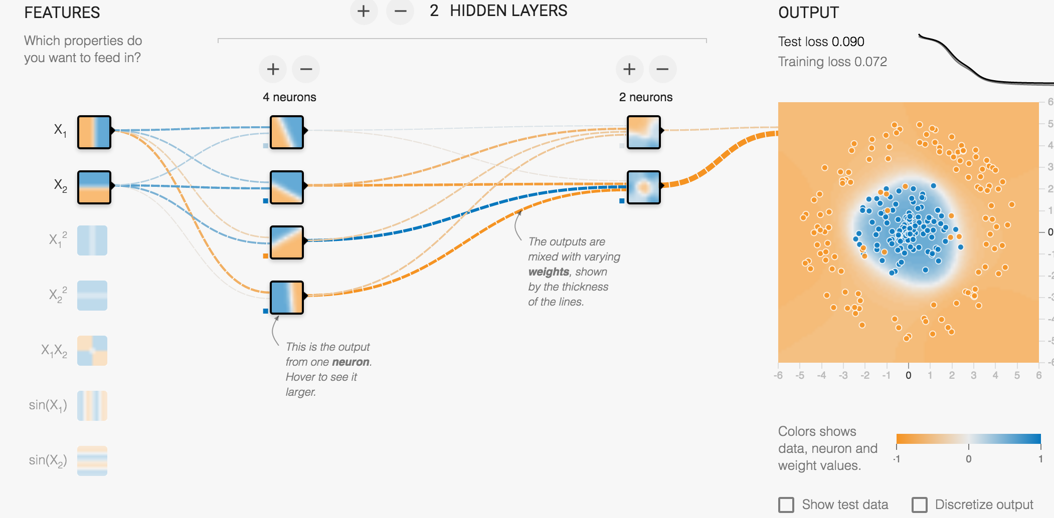
TensorFlow playground: http://playground.tensorflow.org/
Notes:
Also see https://colah.github.io/posts/2014-03-NN-Manifolds-Topology/ for more on how NN’s stretch and squeeze space to perform non-linear classification.

Slide 9
Supervised Learning
x
f(x)
y’
y
Training Data
Model
Prediction

Slide 10
Supervised Learning
x = (x1, x2)
f(x)
y’
y = {“blue”, “orange”}
Training Data
Model
Prediction
e.g. logistic regression: y’ = σ(x₁ w₁ + x₂ w₂ + b)

Slide 11
z
x
xW + b
σ(z)
y’
y
Training Data
Model
Prediction
Logistic Regression

Slide 12
z
x
xW + b
σ(z)
y’
y
Training Data
Model
Prediction
Affine Layer
Non-linearity
Logistic Regression

Slide 13
z
x
xW + b
σ(z)
y’
y
z =
x
W
+
b
Dimensions?
Notes:
(n_x, n_z) n_z = n_y = number of labels if its multi-class (1 if it’s binary)

Slide 14
z
x
xW + b
σ(z)
y’
y
x
W
z =
+
b
Dimensions?
Notes:
x - (1, 2)
W - (2, 1)
b - (1, 1)
z - (1, 1)
y’ - (1, 1)
y - (1, 1)

Slide 15
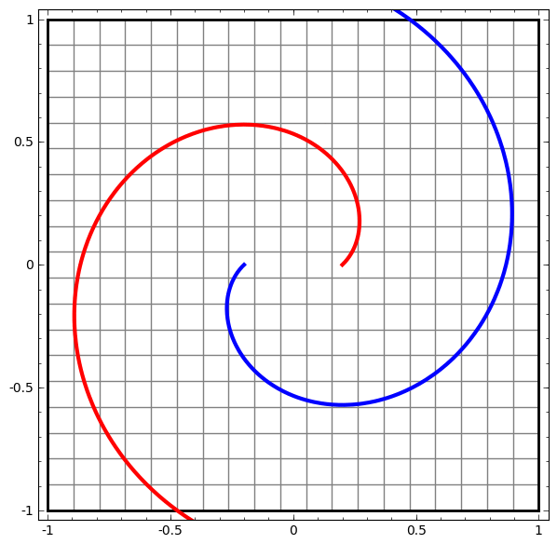
Fully-connected “Affine” Layer
h = f(x W + b)
Affine layer:
Matrix multiply W (rotate & scale)
Bias term b (translate in space)
Then:
Nonlinearity f (squish like dough)
Nonlinearity
Affine
From “Neural Networks, Manifolds, and Topology” (Chris Olah, 2014)
Notes:
One fully connected layer using a sigmoid is logistic regression!

Slide 16
z
x
xW + b
σ(z)
y’
y
z =
x
W
+
b
Batching: more than one x at a time
∑_{i} X_{ai} W_{i} + b = z_{a}
a: batch index, i: ‘incoming’ layer index
Notes:
The layer index i hasn’t been motivated yet. Soon..

Slide 17
z
x
xW + b
σ(z)
etc...
y
z =
x
W
+
b
What if W represents multiple affine transformations?
Each transformation leads to a logistic regression…
...with its own weights and bias parameter!
X W_{k} + b_{k} = z_{k}
k: target layer index

Slide 18
Note: ‘Einstein Convention’ used: Repeated indices are understood to be summed over.)
z₁
x
x_{i}W_{ij} + b_{j}
σ(z_{j})
etc...
y
z =
x
W
+
b
Batching and multiple neurons at the same time
∑_{i} X_{ai} W_{ik} + b_{k} = z_{ak}
a: batch index, i: ‘incoming’ layer index, k: target layer index

Slide 19
Note: ‘Einstein Convention’ used: Repeated indices are understood to be summed over.)
z₁
x
x_{i}W_{ij} + b_{j}
σ(z_{j})
etc...
y
z =
x
W
+
b
X_ai W_i
From Logistic Regression to Neural Nets:
Each neuron is doing a logistic regression… with its own weights and bias parameter! (Note: non-linearity does not have to be sigmoid… more later!)

Slide 20
z₁
h₁
z₂
Y’ = predicted label
x
xW₁ + b₁
relu(z₁)
h₁W₂ + b₂
σ(z₂)
y = actual label
z₁ =
x
W₁
+
b₁
From one to more Hidden Layers:
Output of previous hidden layer is input for next layer

Slide 21
z₁
h₁
z₂
Y’ = predicted level
x
xW₁ + b₁
h₁W₂ + b₂
σ(z₂)
y = actual label
z₁ =
x
W₁
+
b₁
From one to more Hidden Layers:
Output of previous hidden layer is input for next layer
Notes:
z1 = h1W2 + b2
= (xW₁ + b1)W2 + b2
= x(W1W2) + (b1W2 + b2)

Slide 22
z₁
h₁
z₂
Y’ = predicted level
x
xW₁ + b₁
relu(z₁)
h₁W₂ + b₂
σ(z₂)
y = actual label
z₁ =
x
W₁
+
b₁
Question:
- 100-dimensional feature vectors x
- 10,000 examples
- 200 dimensional first hidden layer….
… What are the dimensions of W₁ and b₁?
Notes:
(10000, 200) = (10000, 100) * (100, 200) + (1, 200)

Slide 23

Activations
ReLU (very common) vs. Sigmoid:
Image Source: https://towardsdatascience.com/activation-functions-neural-networks-1cbd9f8d91d6
Notes:
But this is just the surface!

Slide 24
How do we actually classify? Output Layer
Input: 7 dim
HL1 : 12 neurons W_1: 7 x 12
HL 2: 5 neurons W_2: 12 x 5
# of classes: 10
Output Layer: W_o: 5 x 10
Sigmoid Or Softmax
Affine
Output: p =(p_1 , p_2 , , , … p_10)

Slide 25
Output Layer - Approach
If k classes, we need: k probabilities for each input
We have: a last Hidden Layer of (say) dimension d
How do we get the probabilities (k positive numbers summing to 1)?
Use one more affine layer to map from d to k dimensional vectors
Use Softmax:
Exponentiate all elements of vector (now we have k-dim vector with all components positive)
Divide all components by the sum of all components

Slide 26
Softmax
z₁ z₂ z₃
Multiclass sigmoid.\
h_{final} W + b
4 6 -7
Affine
e^{z}
54.5 403.4 0.0009
Softmax
e^{zi} / sum(e^{z})
0.12 0.88 0.00

Slide 27
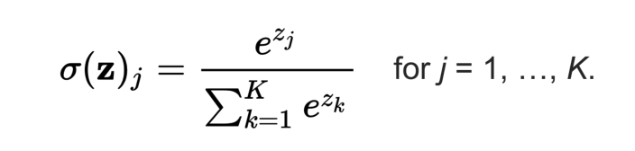
Softmax: the Wikipedia version!
Questions:
“If you have 100k classes… could there be a problem here?”

Slide 28
2 classes
Output of affine layer in classification layer:
3 0
e^3 e^0 = 1
P: e^3/(e^3 +1) 1/(e^3 + 1)

Slide 29
2 Classes: Just Sigmoid
Sigmoid Or Softmax
Affine
Affine
h_{final} W + b
4
e^{z}
54.5
Sigmoid
1 / (1 + e^{-z})
0.98
Question: “How does this relate to Softmax?”
Notes:
Map full range of numbers to positive
Normalize to (0, 1)
Assume negative class is 1 - this value.
Aside: 1/(1 + 1/odds) => probability which implies that z = log(odds) of the positive class

Slide 30
2 Classes: Just Sigmoid
Sigmoid Or Softmax
Affine
Affine
h_{final} W + b
4
e^{z}
54.5
Sigmoid
1 / (1 + e^{-z})
= e^{z} / (e^{z} + 1)
0.98
(… Like comparing to 2nd class that had affine output = 0)
Notes:
Map full range of numbers to positive
Normalize to (0, 1)
Assume negative class is 1 - this value.
Aside: 1/(1 + 1/odds) => probability which implies that z = log(odds) of the positive class

Slide 31
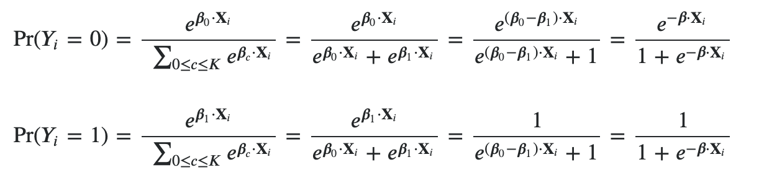
2 Classes: Just Sigmoid
Sigmoid Or Softmax
Affine
Affine
h_{final} W + b
4
e^{z}
54.5
Sigmoid
1 / (1 + e^{-z})
= e^{z} / (e^{z} + 1)
0.98
(… Like comparing to 2nd class that had affine output = 0)
Notes:
Map full range of numbers to positive
Normalize to (0, 1)
Assume negative class is 1 - this value.
Aside: 1/(1 + 1/odds) => probability which implies that z = log(odds) of the positive class

Slide 32

Sigmoid: Intuition
Sigmoid Or Softmax

Slide 33
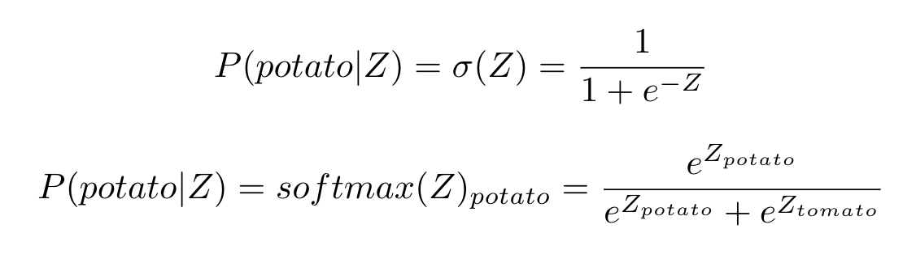
Sigmoid is
binary softmax

Slide 34
Putting it All Together

Slide 35
Fully Connected Network for Classification
Sigmoid Or Softmax
“What are the dimensions for final affine layer if: i) k classes? (k>2) ii) 2 classes? “
Output layer
(“softmax layer”)
Affine
Nonlinearity
Fully-connected layer 2
Affine
Affine
z = xW + b
dim(x) = 1 * m
dim(z) = 1 * n
shape(W) = m x n
Nonlinearity
Fully-connected layer 1
Affine
Features
x₁ x₂
Notes:
Not to be confused with how batteries work

Slide 36
One Last Review of Dimensions

Slide 37
Networks and Matrices
H
X
H
O
H
H
O
X
H
W
W
W
softmax(z)
relu(z)
relu(z)
x
x
x
P
+
=
z
+
=
z
+
z
b
b
b
Question: “How do dimensions change when we look at a batch vs. just one example? (Assume batch size = 4)”
Notes:
Pink = input
H1 = blue
H2 = yellow
Output = green

Slide 38
Networks and Matrices
Mini-batch size = 4
H
X
H
O
H
H
O
X
H
W
W
W
softmax(z)
relu(z)
relu(z)
x
x
x
+
=
+
=
+
=
b
P
b
z
z
b
z
Notes:
Pink = input (4 observations)
H1 = blue (4 hidden states but W and b are same size as they get re-used for each observation)
H2 = yellow (4 hidden states but W and b are same size as they get re-used for each observation)
Output = green (4 predictions)

Slide 39
Why Neural Nets?
Deep computation (multiple layers)
Complex decision boundary
Fewer parameters than big shallow network
Learned representations
Word embeddings
Learn jointly with objective
Key: avoid sparsity problem by computing in dense space
Without sacrificing representation power
Notes:
Of course, must always be careful to avoid overfitting. Neural networks can be very powerful, and overfit in more subtle ways than big sparse models.

Slide 40
Hyperparameters & Other Comments
Hyperparameters:
Number of layers
Dimensions of layers
Regularization parameters (“what? I can overtrain?” “For sure!”)
Choice of non-linearities (sigmoid, tanh, relu,...)
….
Other Comments:
Optimizers (SGD, adam, RMSProp)
Overfitting is a real concern
Cost function is not convex! But it still works...
Notes:
Of course, must always be careful to avoid overfitting. Neural networks can be very powerful, and overfit in more subtle ways than big sparse models.

Slide 41
Neural Net Training: Backpropagation

Slide 42
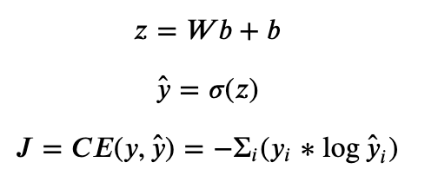
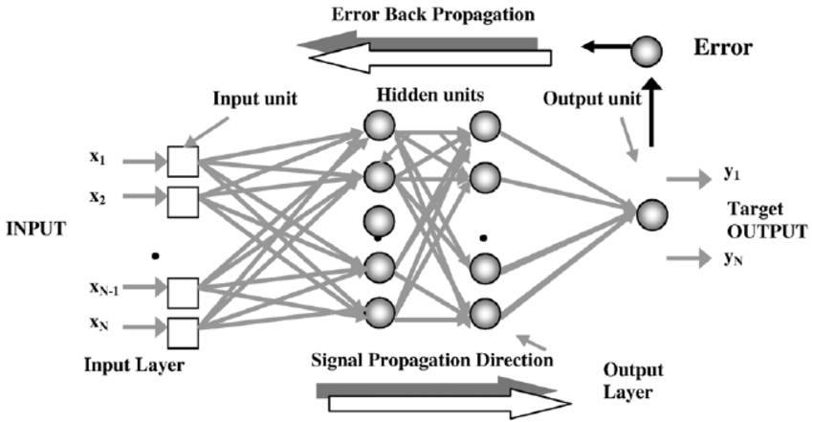
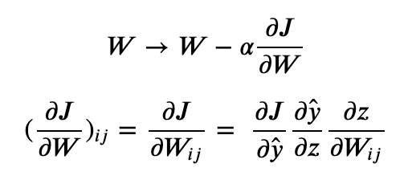
Training: Backpropagation
Unnecessarily scary picture!
It’s just stochastic gradient descent!
Gradient descent + Chain rule = Backpropagation
Parameter update? SGD:

Slide 43
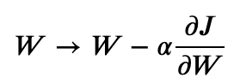
Training: Backpropagation Intuition
loss curve J
(a function of weights)
y-axis : value of loss `J`
x-axis : value of weight `w`

Slide 44
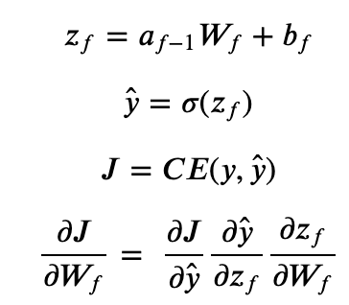
Training: Backpropagation Math
Apply to last layer:

Slide 45
Training: Backpropagation Math
Apply to last layer:
Remember: In general, z_{f} is a vector and w_{f} is a matrix. Therefore: ∂y^/∂z_{f} is a gradient: (∂y^/∂z_{f})_{i} = (∂y^/∂z_{fi})
Similar for w. So really: ∂J/∂(w_{f})_{ij} = ∑_{k} ∂J/∂y_{k}^ x ∂y_{k}^/∂(z_{f})_{k} x ∂(z_{f})_{k}/∂(w_{f})_{ij} Ignoring indices/sums moving forward for illustration...

Slide 46
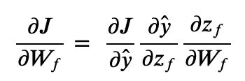
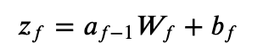
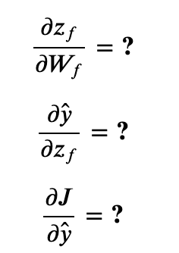
Training: Backpropagation Math

Slide 47
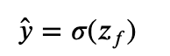
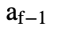
Training: Backpropagation Math
(already calculated during forward pass!)

Slide 48
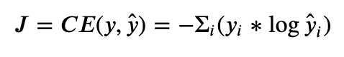
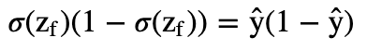
Training: Backpropagation Math

Slide 49
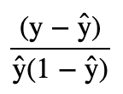
Training: Backpropagation Math
-
(how convenient!)

Slide 50
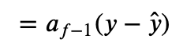
Training: Backpropagation Math
-
Observation: Each operation only needs to know about its internals, what is known from forward pass, and the errors afterwards!
-

Slide 51
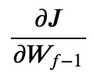
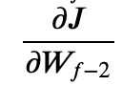
Training: Backpropagation Math
But what about ? Or ?
Do we need to start again?

Slide 52
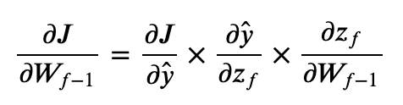
Training: Backpropagation Math
But what about ? Or ?
Do we need to start again?
z_{f-1} = σ(z_{f-2}w_{f-1} + b_{f-1})
Already calculated in ∂J/∂w_{f}

Slide 53
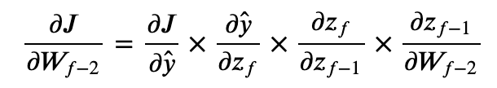
Training: Backpropagation Math
But what about ? Or ?
Do we need to start again?
z_{f-1} = σ(z_{f-2}w_{f-1} + b_{f-1})
z_{f-2} = σ(z_{f-3}w_{f-2} + b_{f-2})
Already calculated in ∂J/∂w_{f}
Already calculated in ∂J/∂w_{f-1}

Slide 54
Training: Backpropagation Math
But what about ? Or ?
Do we need to start again?
Already calculated in ∂J/∂w_{f}
Why is chain rule called backpropagation?
Already calculated in ∂J/∂w_{f-1}

Slide 55
Initialization

Slide 56
Initialization: Why is it important?
∂J/∂w_{f} = ∂J/∂y^ x ∂y^/∂z_{f} x ∂z_{f}/∂w_{f}
Model may not “learn anything”.
What does that mean, concretely?
Look at shape of sigmoid and the
equation above… what might go
wrong?

Slide 57
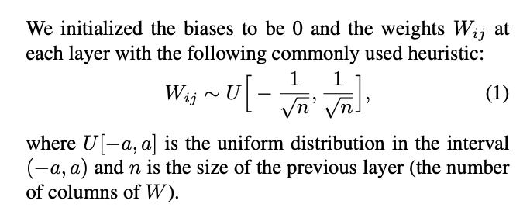
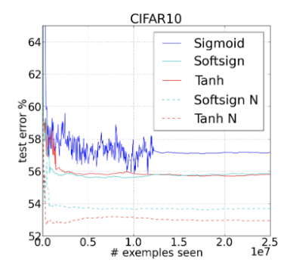
Initialization: Xavier
Generally, Xavier initialization for “w”, 0s for “b”.
Understanding the difficulty of training deep feedforward neural networks, Glorot and Bengio.

Slide 58
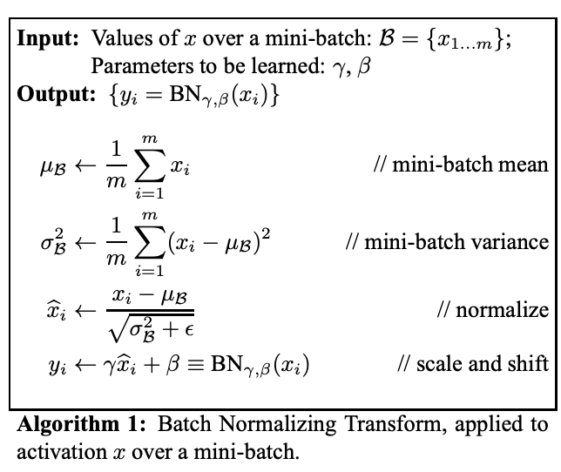
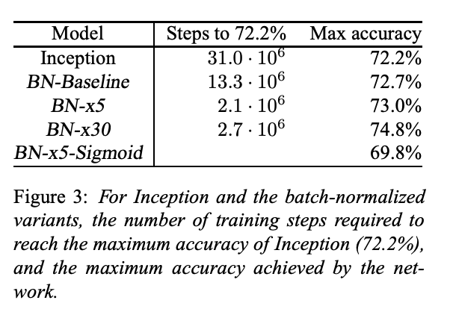
Initialization: Xavier … all the time?
Batch Normalization, Ioffe and Szegedy

Slide 59
Tensorflow documentation is your friend
https://www.tensorflow.org/api_docs/python/
https://keras.io/api/

Slide 60
Next Week!
Text Classification

Slide 61
Appendix/Extras

Slide 62
Cross-Entropy & Average Length per Symbol
In our symbol transmission example, imagine a true and unknown probability distribution P(x) over symbols (‘words’). And, say, P(x) may depend on the previously sent symbols in unknown ways (think: translation), etc.. I.e. HARD to ‘just measure and use’.
A test-person assumes a(nother) history-dependent distribution Q(x) and uses the appropriate Huffman encoding (L ~ - log(Q(x))
How can this test person optimize her/his Q(x)?
Find the length of the overall messages in the training set
Then recalculate length for a slightly modified Q(x) with it’s Huffman encoding. Is it shorter? Then this is a better Q(x). Change Q more in this ‘direction’, etc.
This is exactly minimizing the cross-entropy CE = - ∑_{x} P(x) log Q(x) [summing over all positions over all symbols]

Slide 63
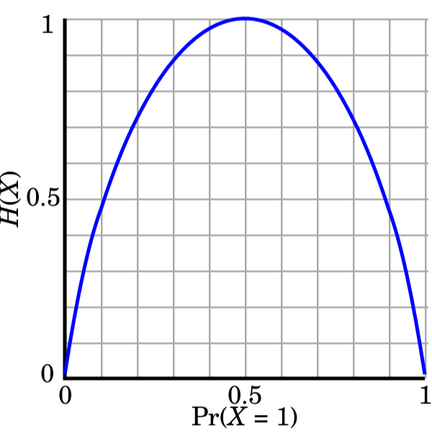
Cross-Entropy & Average Length per Symbol
How short can the average length per symbol get?
S = - ∑_{x} P(x) log P(x) is minimum length. This is the entropy.
What is the Kullback-Leibler Divergence?
D_{KL} = CE - S . Simply subtract S from CE
Why do that?
Min(D_{KL}) = 0. Kind of nice.
But minimizing D_{KL} is the same as minimizing CE… [f(x) = x² -2 x - 5 minimizes at the same x as g(x) = x² - 2x ]

Slide 64
Some Easy Questions
Assume:
Fully connected layer with an input batch of examples coming in to a neural net. Batch size is 8, and each example has 12 features
The first hidden layer has dimension 10
The equation for the output of the hidden layer is given by:
y = σ(x W + b)
Questions: What are the dimension of
x?
W?
b?
Please put the answers in the chat… 60 s

Slide 65
(Old) TensorFlow

Slide 66
Tensorflow Ideas
In Tensorflow calculations are done first by setting up the plumbing (“graph”) to define data flow. Tensors are data “nodes” in the graph. Data flows sequentially through the graph one step at a time. Each step progression is triggered by session.run(...) The Tensorflow platform provides cutting-edge libraries for doing amazing things:
simple things (such as adding two tensors together or multiplying vectors or matrices), or
more complex things (such as optimizing a model to minimize cross-entropy loss.)

Slide 67
What’s a Tensor?
Tensor: Just a fancy name for an array in tensorflow. Analogous to numpy arrays.
The most important types of tensors are:
Constants and sequences, for example: tf.constant(), tf.zeros(), tf.linspace(). These create Tensors with a fixed value.
Variables, are persistent tensors and can be modified during execution. They are used for model parameters, (for example weight matrices), and get updated by training.
Placeholders, are used as data inputs. These are empty variables (hence the name) and must be fed with data during a session.run() operation.
Operations, hold the result of an operation with 1 or more inputs. They can have inputs of placeholders, variables, constants, or other operations (depending on the operation.)

Slide 68
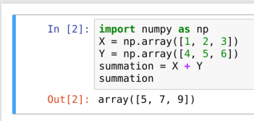
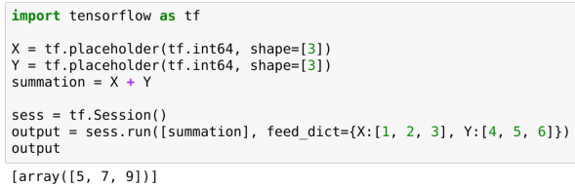
X
+
Y
Computational Graph
NumPy
TensorFlow

Slide 69
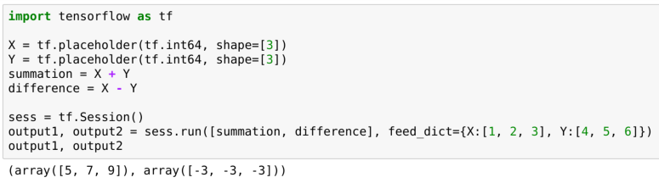
X
Multiple nodes in the graph can be evaluated simultaneously.
But...
You are not obliged to evaluate every node.
+
Y
-
Computational Graph
Notes:
Ideas for additional Tensorflow material:
1) summarizing placeholder / variable / operations
2) Discussing graph connections
3) Pointing out that tensorflow document is your friend...

Slide 70
FC Layer Build-Up

Slide 71
Networks and Matrices
Mini-batch = 4
Dim(x) = ?
H
X
H
O
H
H
O
X
H
W
W
W
softmax(z)
relu(z)
relu(z)
x
x
x
+
=
+
=
+
=
b
P
b
z
z
b
z

Slide 72
Networks and Matrices
Mini-batch = 4
Dim(W) = ?
H
X
H
O
H
H
O
X
H
W
W
W
softmax(z)
relu(z)
relu(z)
x
x
x
+
=
+
=
+
=
b
P
b
z
z
b
z

Slide 73
Networks and Matrices
Mini-batch = 4
Dim(b) = ?
H
X
H
O
H
H
O
X
H
W
W
W
softmax(z)
relu(z)
relu(z)
x
x
x
+
=
+
=
+
=
b
P
b
z
z
b
z

Slide 74
Networks and Matrices
Mini-batch = 4
Dim(z) = ?
H
X
H
O
H
H
O
X
H
W
W
W
softmax(z)
relu(z)
relu(z)
x
x
x
+
=
+
=
+
=
b
P
b
z
z
b
z

Slide 75
Networks and Matrices
Mini-batch = 4
Dim(activation) = ?
H
X
H
O
H
H
O
X
H
W
W
W
softmax(z)
relu(z)
relu(z)
x
x
x
+
=
+
=
+
=
b
P
b
z
z
b
z

Slide 76
Networks and Matrices
Mini-batch = 4
Dim(W) = ?
H
X
H
O
H
H
O
X
H
W
W
W
softmax(z)
relu(z)
relu(z)
x
x
x
+
=
+
=
+
=
b
P
b
z
z
b
z

Slide 77
Networks and Matrices
Mini-batch = 4
Dim(b) = ?
H
X
H
O
H
H
O
X
H
W
W
W
softmax(z)
relu(z)
relu(z)
x
x
x
+
=
+
=
+
=
b
P
b
z
z
b
z

Slide 78
Networks and Matrices
Mini-batch = 4
Dim(z) = ?
H
X
H
O
H
H
O
X
H
W
W
W
softmax(z)
relu(z)
relu(z)
x
x
x
+
=
+
=
+
=
b
P
b
z
z
b
z

Slide 79
Networks and Matrices
Mini-batch = 4
Dim(activation) = ?
H
X
H
O
H
H
O
X
H
W
W
W
softmax(z)
relu(z)
relu(z)
x
x
x
+
=
+
=
+
=
b
P
b
z
z
b
z

Slide 80
Networks and Matrices
Mini-batch = 4
Dim(W) = ?
H
X
H
O
H
H
O
X
H
W
W
W
softmax(z)
relu(z)
relu(z)
x
x
x
+
=
+
=
+
=
b
P
b
z
z
b
z

Slide 81
Networks and Matrices
Mini-batch = 4
Dim(b) = ?
H
X
H
O
H
H
O
X
H
W
W
W
softmax(z)
relu(z)
relu(z)
x
x
x
+
=
+
=
+
=
b
P
b
z
z
b
z

Slide 82
Networks and Matrices
Mini-batch = 4
Dim(z) = ?
H
X
H
O
H
H
O
X
H
W
W
W
softmax(z)
relu(z)
relu(z)
x
x
x
+
=
+
=
+
=
b
P
b
z
z
b
z

Slide 83
Networks and Matrices
Mini-batch = 4
Dim(P) = ?
H
X
H
O
H
H
O
X
H
W
W
W
softmax(z)
relu(z)
relu(z)
x
x
x
+
=
+
=
+
=
b
P
b
z
z
b
z

Slide 84
Networks and Matrices
Mini-batch = 4
That’s it!
H
X
H
O
H
H
O
X
H
W
W
W
softmax(z)
relu(z)
relu(z)
x
x
x
+
=
+
=
+
=
b
P
b
z
z
b
z

